Slide 1
Exporting in Transition and Exchange Rate Systems
CAMILLA Jensen, denmark
Ausra rasteniene, Dept. Of Economics, Vilnius University, Lithuania

Slide 2
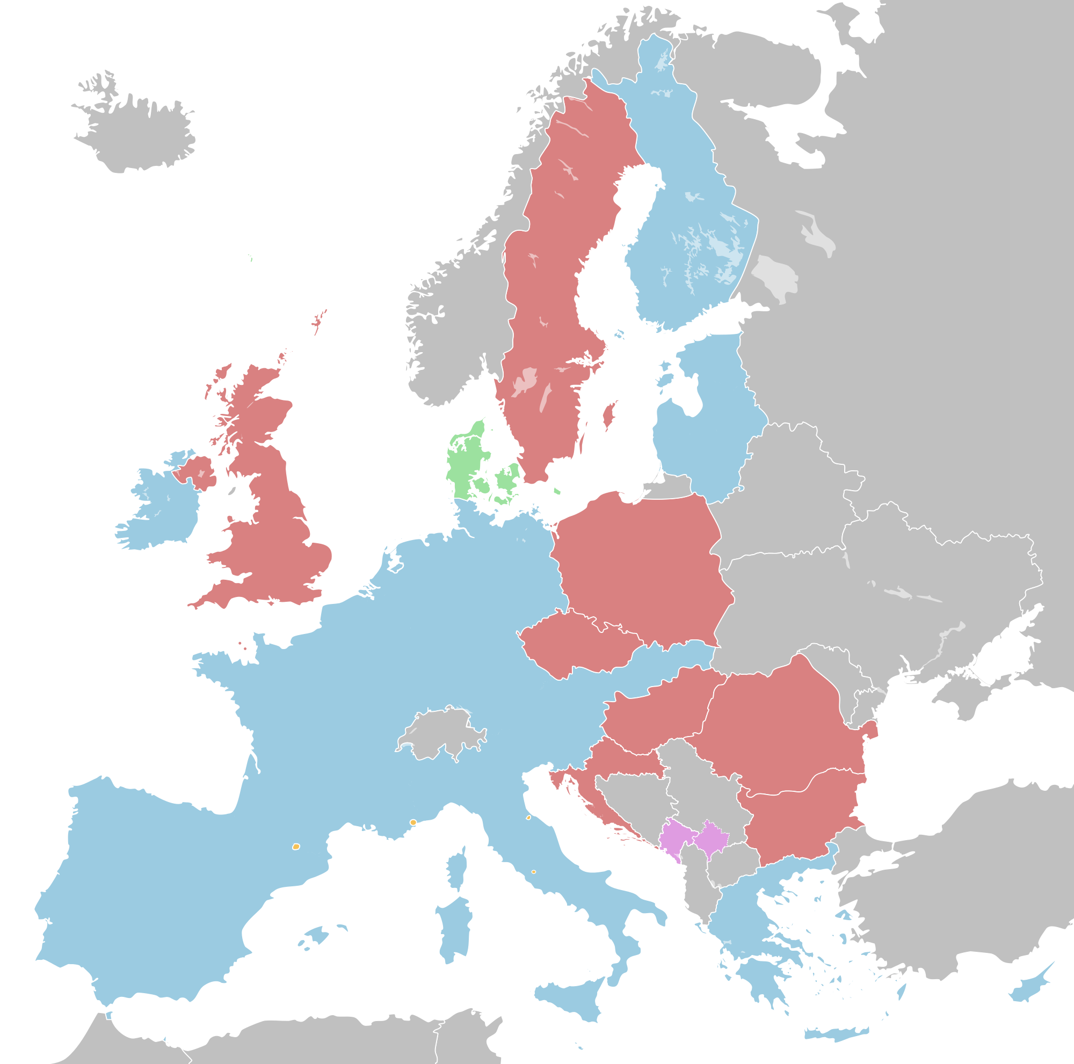
Background
How do horisontal policies such as exchange rate systems matter for firm performance and in particular exporting?
-Bernard and Jensen(2004)
-Desai, Foley and Forbes (2005)
-Berman, Martin and Mayer (2012)
-Cheung and Sengupta (2013)
-Li, Ma, Xu, Xhiong (2015)

Slide 3

Research questions – comparative or ‘institutional’ level
Hypothesis/premise: Out of crisis fixed exchange rate regimes perform best under certain conditions (low inflation environment, stable monetary policy)
Question: Which regime performed best during the crisis from the perspective of exporters and all firms in general? And why?
Potential question (to be answered by others): What are the necessary conditions to be ready for the Euro in the current economy?

Slide 4

Research questions - Country level
But first much more basic research questions at the case level (see also our paper on Lithuania published in Ekonomika http://www.journals.vu.lt/ekonomika/article/view/10128/7994):
• Did the financial crisis cause an increase or decrease in the number of exporters?
• Did exporters increase or decrease their export levels in relative (percentage) and absolute (value) terms?
• Did the financial crisis lead to a change in the characteristics (such as size, sector, sales growth and ownership) of the average exporting firm in Lithuania, and if so, what has been the direction of change in the population of exporters relative to non-exporters?
• Did exporters fare overall better or worse than other non-exporting firms in the financial crisis?

Slide 5

Methodology – how can we chase out institutional effects in economics?
Wooldridge, J. M. (2003). Cluster-sample methods in applied econometrics.The American Economic Review, 93(2), 133-138.

Slide 6

Our proposed methodology
Case studies at the country level combined with econometrics at the firm-level to control for heterogeneity

Slide 7
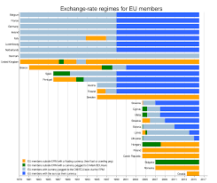
Sampling cases
Lithuania
Slovakia
Poland
Czech Republic

Slide 8
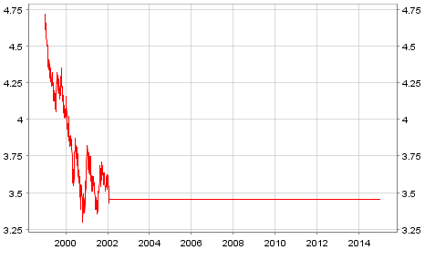
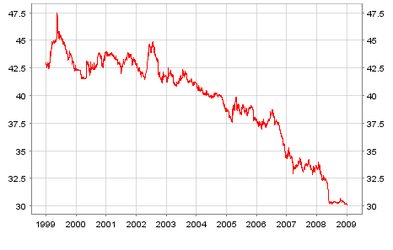
Lithuania and Slovakia

Slide 9
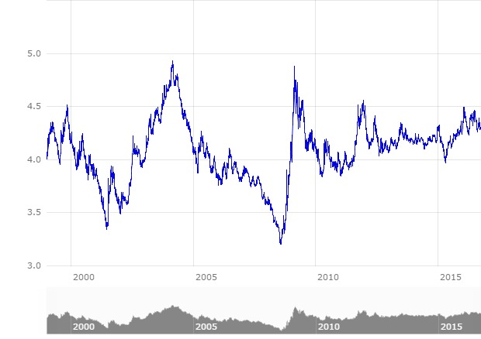
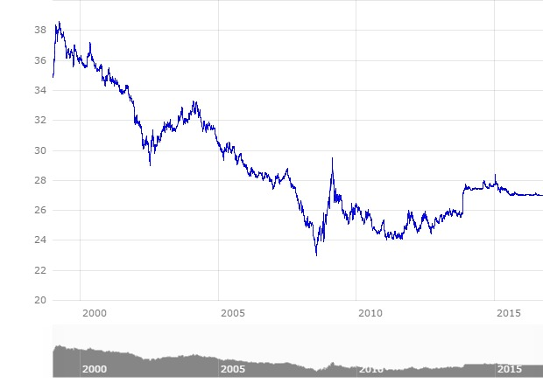
Poland and Czech Republic

Slide 10
Case comparison – descriptive statistics
Of the four countries only Slovakia has fallen significantly behind in its export performance after the crisis:
-No. of exporters dropped
-Export intensity has declined
-Exported value goes down
-Foreign investment participation in exports decline
But! Sampling, sampling, sampling..

Slide 11
Remainder of analysis concerns making robustness checks controlling for:
-Sampling and general firm heterogeneity using econometric analysis
But here we just initially control for the very general activity code of the firms with dummies for: administriation, construction, manufacturing, tourism, trade and transport
-Focusing only on manufacturing firms
-Controlling in more detail for the differences in industrial structure of the four countries:
Using Broad Economic Classification of goods from the UN (concordances are a challenge here!) http://unstats.un.org/unsd/cr/registry/regcst.asp?Cl=10
Controlling at the detailed activity/industry level with 3-digit ISIC codes

Slide 12
Preliminary results
General heterogeneity
ManufacTUrinG ONLY

Slide 13
Preliminary results
3-DIGIT ISIC CODES
BEC CODES
Forthcoming…

Slide 14
Discussion

Slide 15


